Slide 1
Tractography for Brain Tumor Surgery
Nurgul Kermakunova, Ali Berrada
17/12/2018

Slide 2
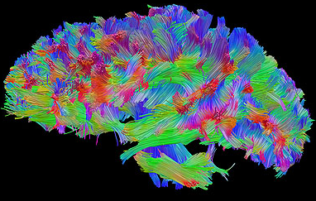
Content
Part I: Introduction
Part II: Diffusion Tensor Imaging
Notes:
Ref: http://www.neurosurgery.pitt.edu/research/fiber-tractography-lab

Slide 3
Introduction

Slide 4
Context
Brain Tumor
(CAD)
Tractography
Neurosurgery
Notes:
We want to look at the importance of tractography from a neurosurgery perspective.
Tractography helps surgeon during brain operation to avoid affecting important white matter tracts.

Slide 5
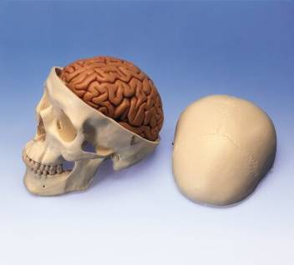
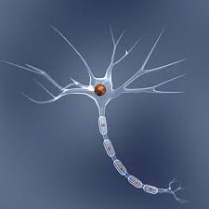
Cortex
The surface of the brain is called the cortex.
The cortex contains 16 billion neurons
Neuron

Slide 6
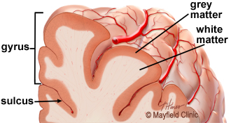
Under the cortex
Beneath the cortex are long nerve fibers (axons) that connect areas of the brain to each other, called white matter.

Slide 7
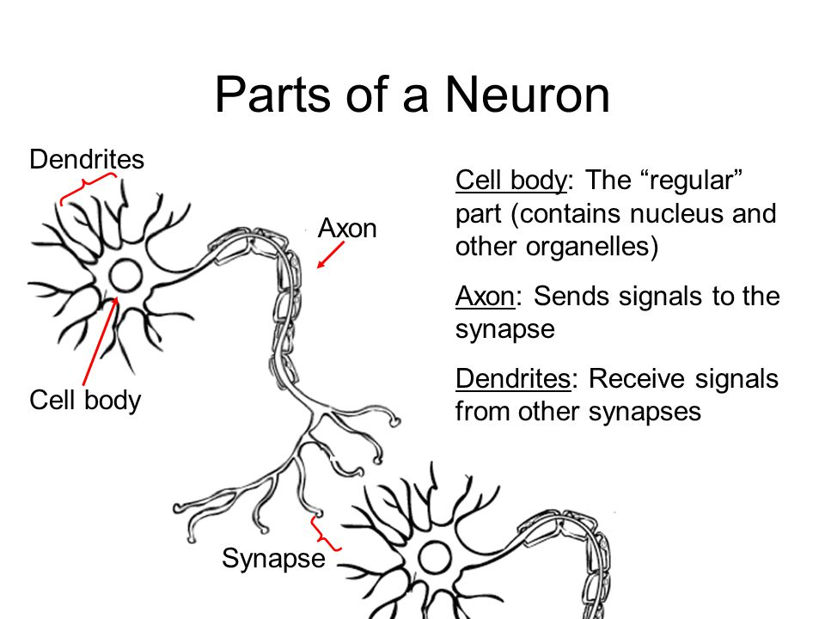
Structural Unit
Notes:
The main structure studied in tractography is the bundle of axons.
Motor neuron: the main microstructure of the motor cortex (precentral gyrus).

Slide 8
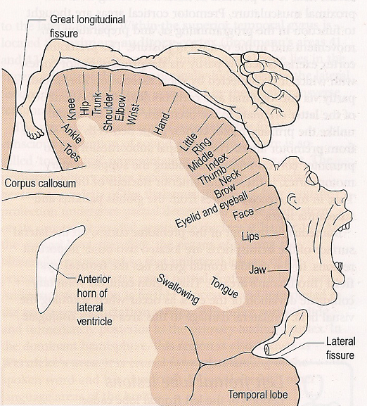
Importance of the precentral gyrus
Notes:
The image shows the precentral gyrus.
It is a map of the location of functional zones on the surface of the cortex of this gyrus.
Damage to some parts (e.g. during surgery) may have drastic effect on patient’s life and functions.

Slide 9
Side Effects of brain tumor surgery
Postoperative motor deficit is one of the main complications of brain tumor neurosurgery.
Some causes of complications:
tissue shift during surgery
complex relationship of the tumor with the motor tract
According to a study by prof. C. De Witt , based on the meta-analysis of 90 publications (8091 clinical cases), early neurological disorders of any degree were detected in 30.3% of patients with supratentorial gliomas removal, and gross disorders in 22.9 %.

Slide 10
Task of the surgeon
Remove as much of the tumor as possible to slow its growth and avoid damage to vital structures.
Tractography can help surgeon not damaging to the motor tracts.

Slide 11
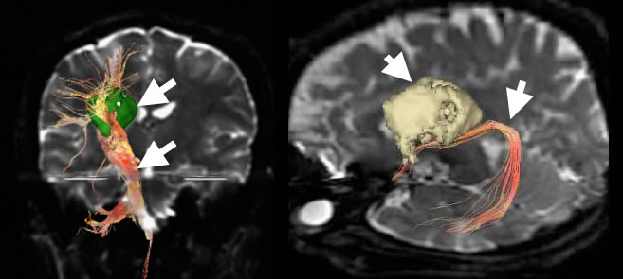
The nerve fibers of the brain, close to the tumor, are depicted in a three-dimensional way, showing a positional relationship.
Notes:
Image shows interaction oligodendrogliomas and functional pathways (with help of tractography).
This helps the surgeon during the tumor removal.

Slide 12
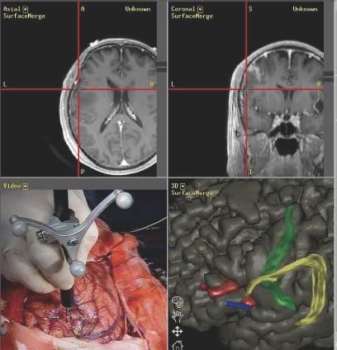
Neuronavigation
Localizes the tumor during surgery.
Provides a safe and more reliable operation.
Notes:
One of the ways to solve the complex problem is the navigation method

Slide 13
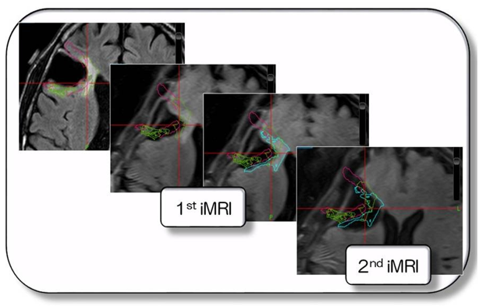
Intraoperative MRI
Notes:
One of the ways to solve the complex problem is the intraoperative MRI.
Here we are able to detect tissue shift which is a common issue in neurosurgical procedures.

Slide 14
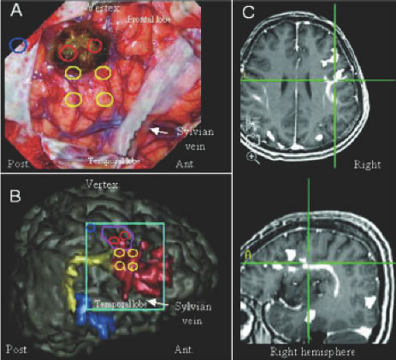
Integration of different techniques
The integration of the functional MRI, tractography, magnetoencephalography, etc., creates images aimed at safe surgery.

Slide 15
Diffusion Tensor Imaging

Slide 16
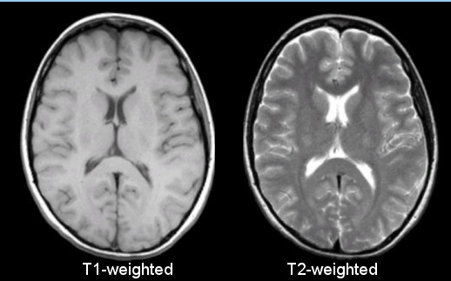
T1 and T2 weighted images
White Matter appears homogeneous.
Tracts/connections are not visible.
Notes:
Neurons are in GM and the axons in WM.
In T1 or T2 weighted images, the WM looks as a homogeneous field and no information about the wiring existing internally can be drawn.
Ref: http://casemed.case.edu/clerkships/neurology/web%20neurorad/mri%20basics.htm

Slide 17
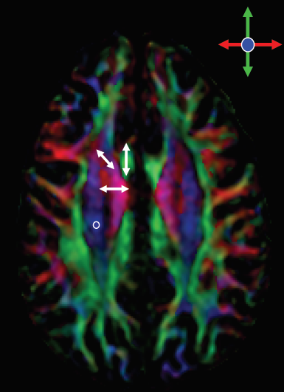
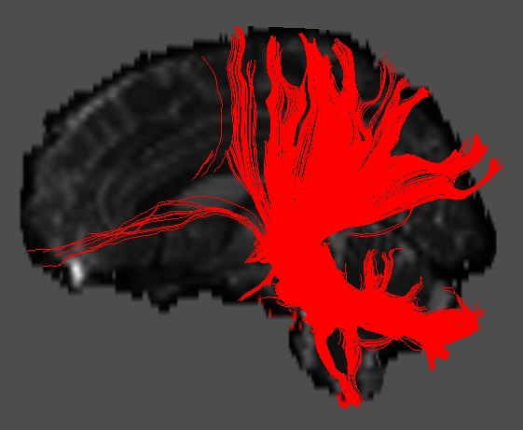
Diffusion Tensor Imaging
White matter structure revealed.
3D reconstruction of axonal tracts becomes possible.
Orientation map
Fiber tracking
Notes:
DTI allows to generate color-coding orientation maps of the fibers. The anatomy of WM is revealed.
Red: Left <–>Right
Green: Front <-> Back
Blue: Top <-> Bottom
Mixture of colors: oblique orientation
Ref: http://mriquestions.com/dti-tensor-imaging.html

Slide 18
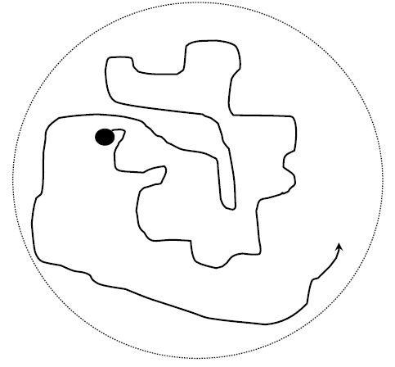
What is measured in DTI
Water motion.
Notes:
In DTI, the motion of water is measured.

Slide 19
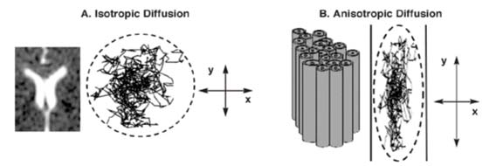
Diffusion of water molecules
Isotropic vs Anisotropic diffusion
Underlying structures of the tissues
Faster diffusion along fibers than perpendicular to them.
Water diffusion anisotropy used to track fibers, estimate white matter integrity
Notes:
If the diffusion motion is random, it is called isotropic diffusion. It implies that the environment is random.
If the diffusion is more into certain directions than others, it is called anisotropic diffusion. It implies that there must be some coherent structures like fascicles (axonal bundles).
Ref: ROCEANU, A. (2012). Diffusion tensor imaging (DTI)-A new imaging technique applied in multiple sclerosis.

Slide 20
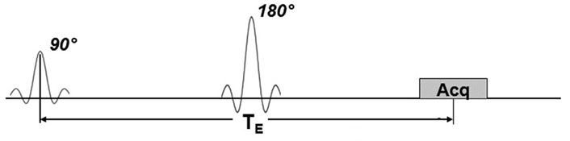
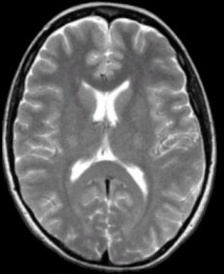
Spin-echo sequence
T2-weighted image
Notes:
Spin-echo sequence to generate T1- or T2-weighted images.

Slide 21
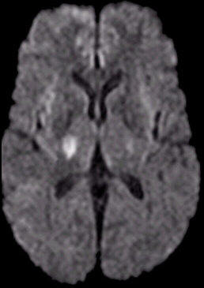
Diffusion sequence
Diffusion-weighted image
Notes:
The pulsed gradient spin echo technique is the basis of the diffusion-weighted pulse sequences.
In addition to the conventional spin-echo sequence, a diffusion-sensitizing gradient (DG) is applied before and after the 180° pulse to obtain the diffusion weighted image.
In this example of DWI, the bright spot reveals acute infarction (stroke) which would not be detected in other sequences.
In DWI, dark = high diffusion, bright = low diffusion.

Slide 22
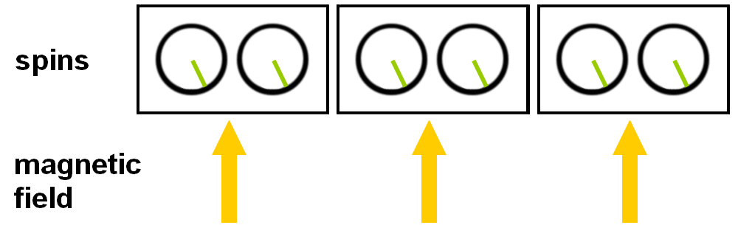
Homogeneous magnetic field
All water molecules experience the same amount of magnetic field.
They rotate at the same frequency and are in phase.

Slide 23
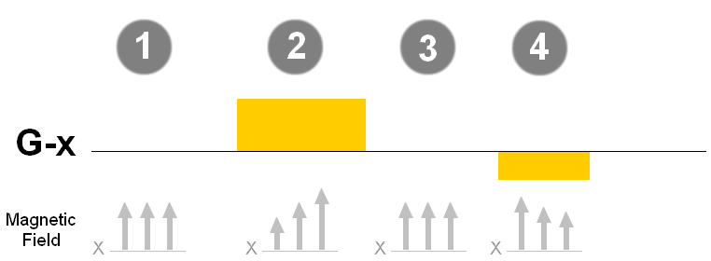
Example of Gradient application
1. Gradient turned off
2. Strong and long positive x-gradient applied
3. Gradient turned off
4. Short and weak negative x-gradient applied
Notes:
Gradient allows to change the magnetic field along the X, Y and Z axes in a linear fashion.
Weak/strong, short/long, positive/negative gradients can be applied to control the homogeneity of the magnetic field strength linearly.

Slide 24
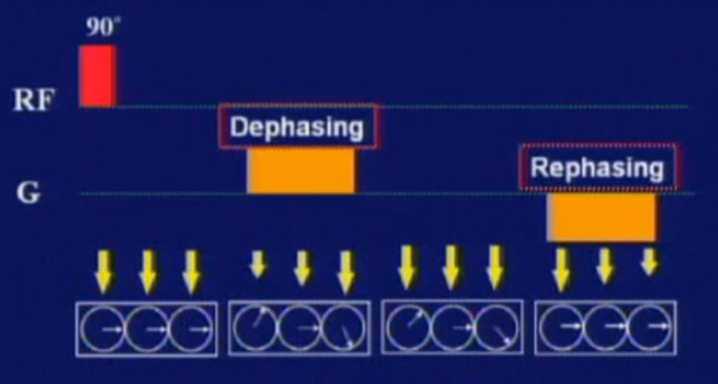
Effect of Gradient on spins
Notes:
Before the gradient is turned on, the magnetic field is homogeneous and the molecules spin at the same frequency.
When the positive gradient is applied (called “de-phasing gradient”), the molecules spin at different speed so they are de-phased.
When the gradient is turned off, the molecules rotate at the same speed but are still de-phased.
When the negative gradient is applied (called “re-phasing gradient”), the molecules regain phase.

Slide 25
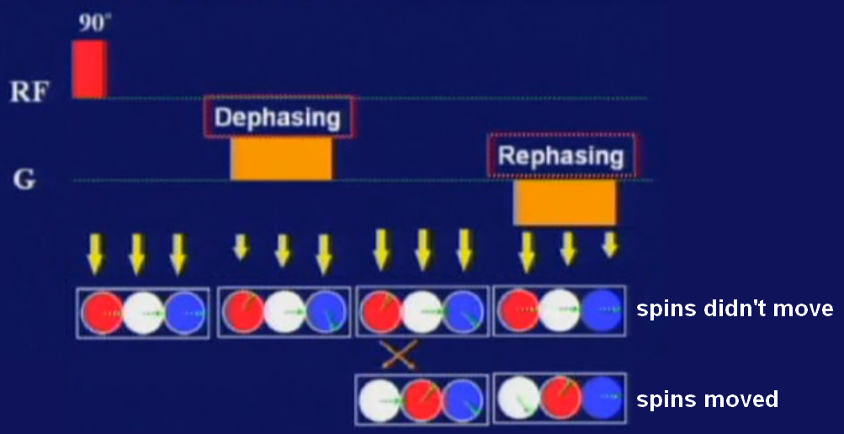
Imperfect refocusing
If water molecules moves, re-phasing is not attained.
This leads to signal loss.
Notes:
If 2 molecules switch position, they do not re-phase when the negative gradient is applied.
In MRI, the signal is not detected from each water molecule, rather the signal is the result of the sum of all spin vectors.
Therefore there is signal loss when spins move.

Slide 26
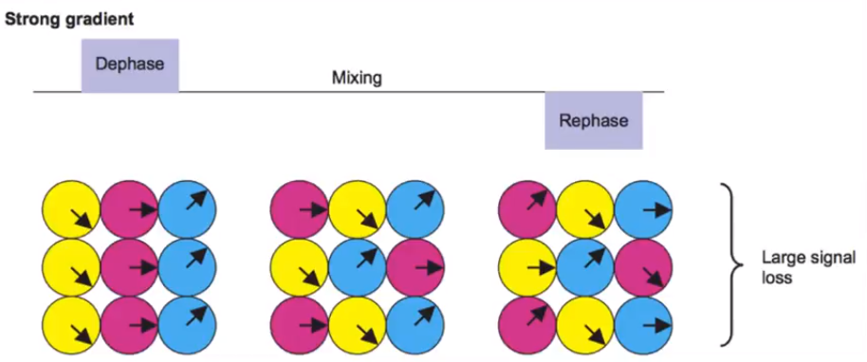
Measuring diffusion
The more water molecules move (diffuse), the more the signal loss.
This is what enables the measurement of the diffusion constant.

Slide 27
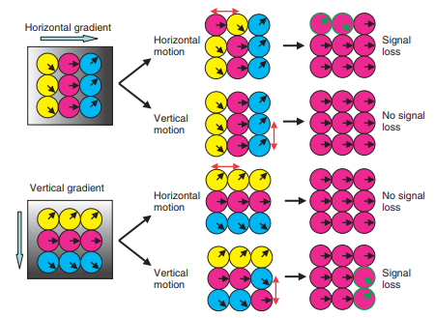
Measuring diffusion
Only the diffusion along a gradient direction can be measured.
Relationship between gradient orientation, molecular motion, and signal loss. When the horizontal gradient is used, molecular motions along the horizontal axis lead to signal loss.
Notes:
Only the diffusion along a gradient direction can be measured.
For example, if the x-gradient is applied, we can only measure diffusion along the X-direction and the movement of molecules in Y- or Z-direction is not contributing to signal loss.
Ref: Introduction to Diffusion Tensor Imaging, Susumu Mori.)

Slide 28
Measuring Diffusion
S = S_{o} e^{−bD}
S: signal measured
S_{o}: baseline MR signal
b: parameter reflecting strength and length of applied gradient
D: diffusion coefficient

Slide 29
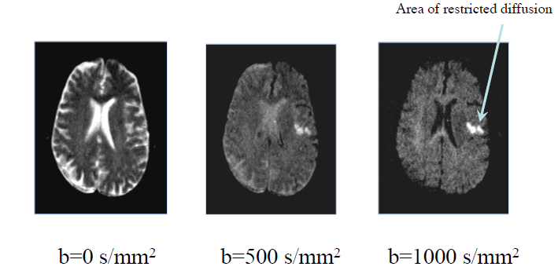
DWI b-value
Notes:
Effect of changing the b-value.

Slide 30
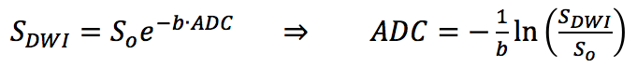
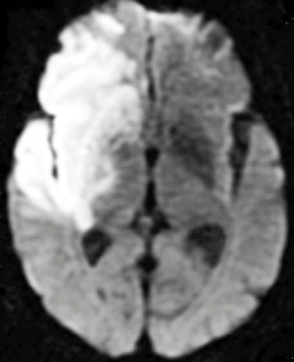
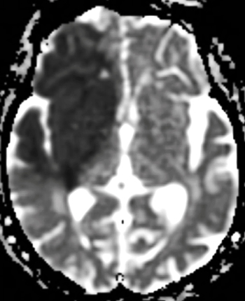
ADC Map
Trace DWI of stroke
ADC map of stroke
Notes:
Apparent Diffusion Constant (ADC) images are pure maps of the diffusion coefficient.
In ADC maps, dark is low/slow diffusion and bright is high/fast diffusion.
Stroke has low ADC so it appears dark on ADC map.
The ADC map gives a lot of information about axonal structures.
Ref: http://mriquestions.com/trace-vs-adc-map.html

Slide 31
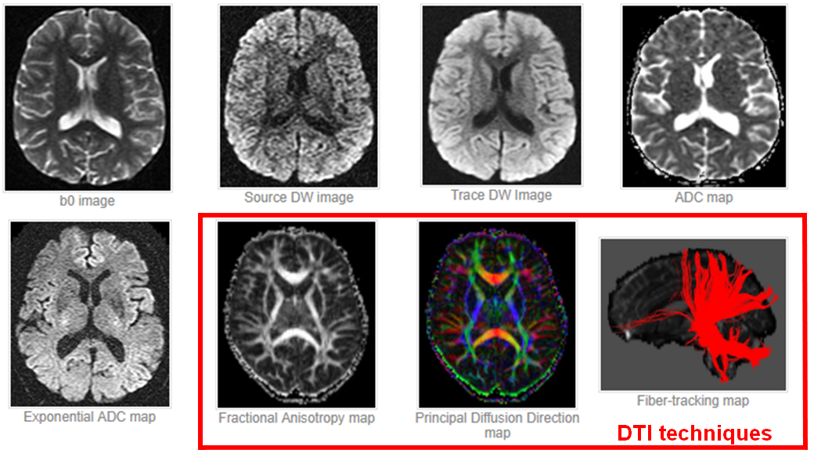
DW Images and Derived Maps
Notes:
From http://mriquestions.com/making-a-dw-image.html:
The following steps are automatically performed to generate DW images and their associated maps:
1- The DW pulse sequence is first run with the DG's turned off or set to a very low value. This generates a set of b0 ("b-zero") images that are T2-weighted and will serve as a baseline for later calculated maps. (For abdominal imaging b50 images are often obtained, the small but nonzero gradient amplitude helping to suppress signal in vessels).
2- The DW sequence is then run with the DG's turned on individually or in combination and at various strengths. This produces DW source images sensitized to diffusion in multiple different directions.
3- The DW source images are combined to produce a set of Trace DW images, the first-line images used for clinical diagnosis.
4- An Apparent Diffusion Coefficient (ADC) map is then calculated using the data from the b0 and source images. The ADC map is used to clarify abnormalities seen on the trace images.
5- Further advanced processing can be optionally performed, creating additional calculated image sets for analysis. These may include exponential ADC maps, fractional anisotropy images, principal diffusion direction maps, and fiber tracking maps.

Slide 32
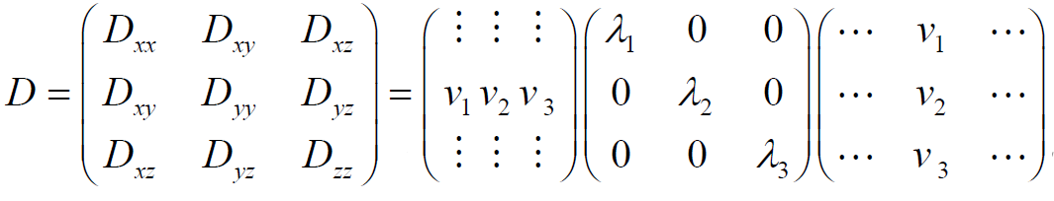
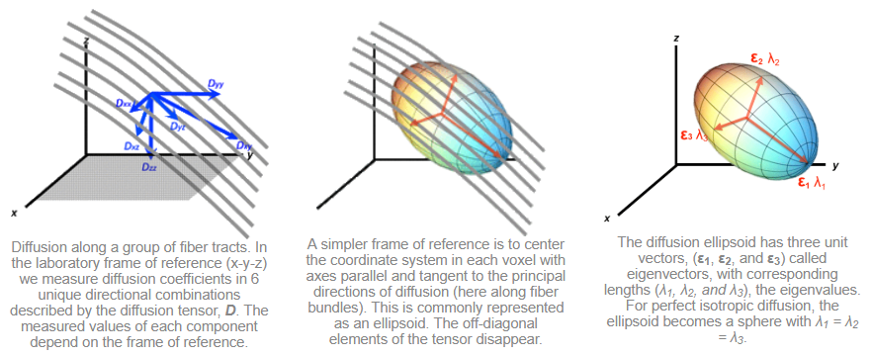
(Anisotropic) Diffusion Tensor
Notes:
ADC reduces the diffusion to a single mean value.
In DTI, diffusion is modeled using “the diffusion tensor, a [3 x 3] array of numbers corresponding to diffusion rates in each combination of directions”.
We measure the diffusion constant along 6 directions (i.e. 6 source data sets) in addition to the baseline (b=0).
Mathematical fitting is applied on these measurements to simulate the diffusion property of water molecule as an ellipsoid.
Ref: http://mriquestions.com/diffusion-tensor.html

Slide 33
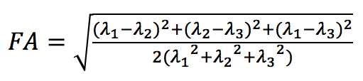
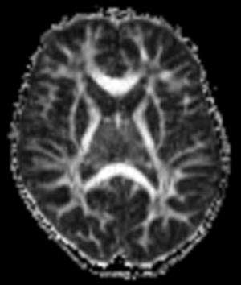
Fractional Anisotropy Map
Fractional anisotropy (FA): index for the degree of diffusion happening within a voxel
Ranges between 0 (isotropic diffusion) and 1 (diffusion along 1 axis only).
Notes:
After the diffusion of water molecules is measured at each voxel, we can generate a Fractional Anisotropy map: a contrast image of FA values across the image.
Bright means more anisotropy.

Slide 34
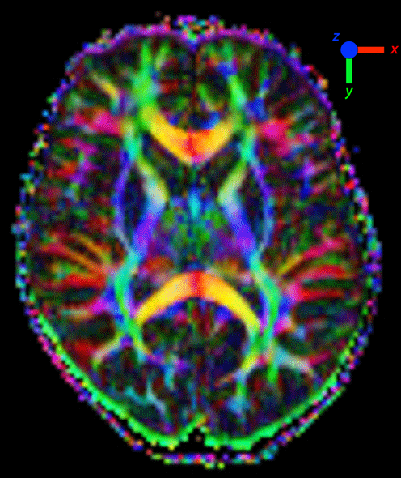
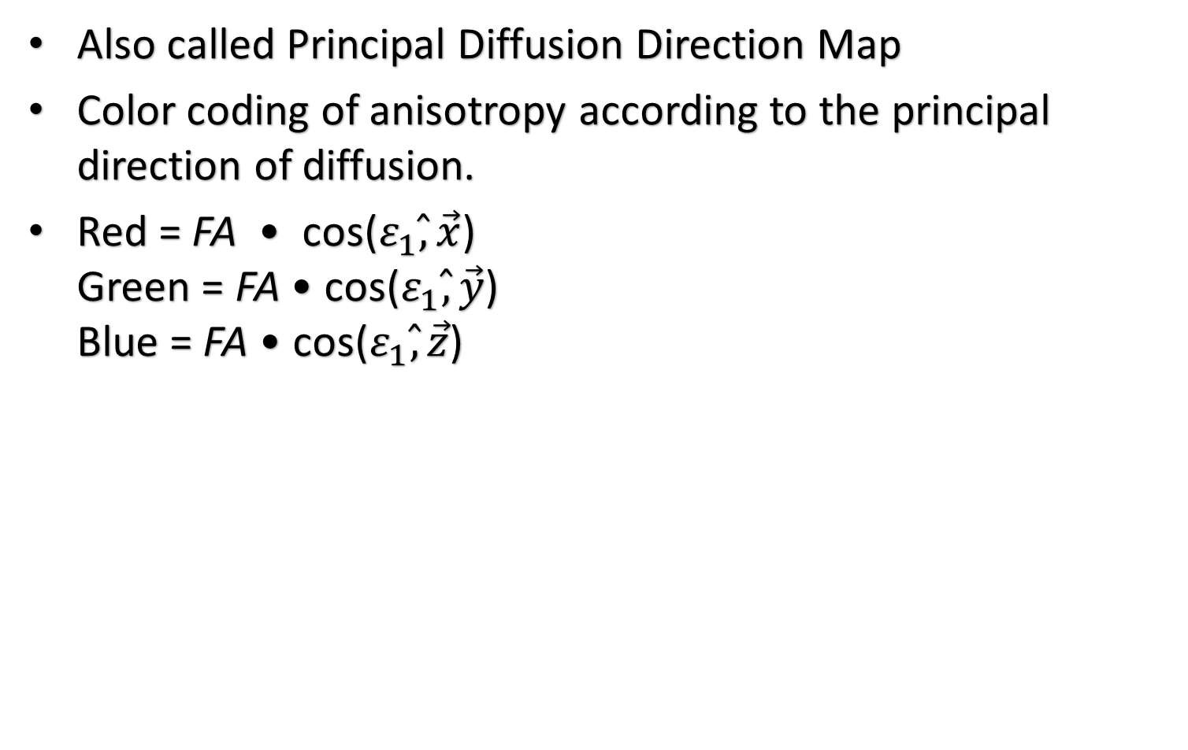
Color Fractional Anisotropy Map
Also called Principal Diffusion Direction Map
Color coding of anisotropy according to the principal direction of diffusion.
Red = FA • cos($ε_{1}\hat{,}\vec{x}$) Green = FA • cos($ε_{1}\hat{,}\vec{y}$) Blue = FA • cos($ε_{1}\hat{,}\vec{z}$)

Slide 35
Fiber Tracking Map
Deterministic methods:
Connect-the-voxels (Conturo)
FACT (Mori, DTIStudio)
Path-integral method (Basser, Tuch)
Notes:
Once we get the information from multiple orientations at each pixel, we can trace this information to obtain 3D trajectory.
At each voxel, average fiber orientation can be obtained.
2 thresholds for termination:
Sharp turn: not enough resolution to follow this pathway
Low anisotropy area: no dominant fiber orientation. E.g. GM, larger noise effect, …

Slide 36
FACT
FACT (Fiber Assignment by Continuous Tracking)
User selects "seed voxels" in a certain area of the brain.
Automated software computes fiber trajectories in and out of that area.
Follows the primary eigenvector (ε1) in each voxel until it encounters a neighboring voxel.
Trajectory is changed to point in the direction of the new eigenvector.

Slide 37
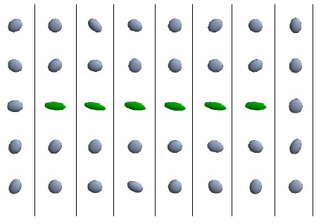
Fiber track reconstruction
Tensor data
Notes:
Ref: Diffusion tensor imaging and fiber tractography of human brain pathways, Brian Wandell.

Slide 38
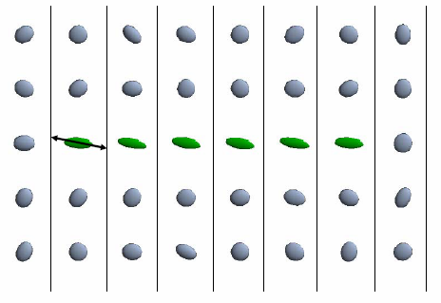
Fiber track reconstruction
Start from a Seed
Notes:
Ref: Diffusion tensor imaging and fiber tractography of human brain pathways, Brian Wandell.

Slide 39
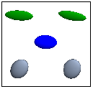
Fiber track reconstruction
Interpolate a new tensor
Notes:
Ref: Diffusion tensor imaging and fiber tractography of human brain pathways, Brian Wandell.

Slide 40
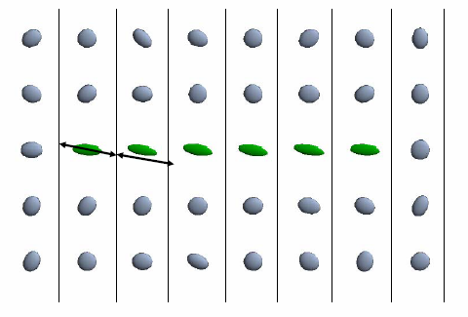
Fiber track reconstruction
Take next step
Notes:
Ref: Diffusion tensor imaging and fiber tractography of human brain pathways, Brian Wandell.

Slide 41
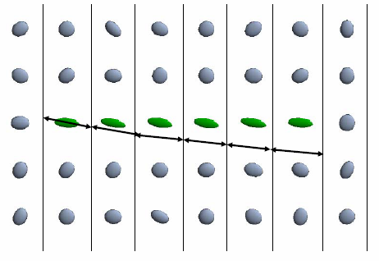
Fiber track reconstruction
Repeat until termination condition
Notes:
Ref: Diffusion tensor imaging and fiber tractography of human brain pathways, Brian Wandell.

Slide 42
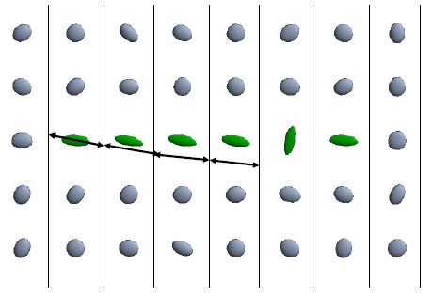
Fiber track reconstruction
Termination criteria 1: sharp turn
Notes:
Ref: Diffusion tensor imaging and fiber tractography of human brain pathways, Brian Wandell.

Slide 43
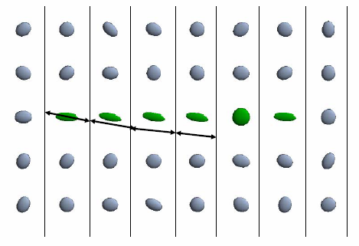
Fiber track reconstruction
Termination criteria 2: isotropy (e.g. entering GM area)
Notes:
Ref: Diffusion tensor imaging and fiber tractography of human brain pathways, Brian Wandell.

Slide 44
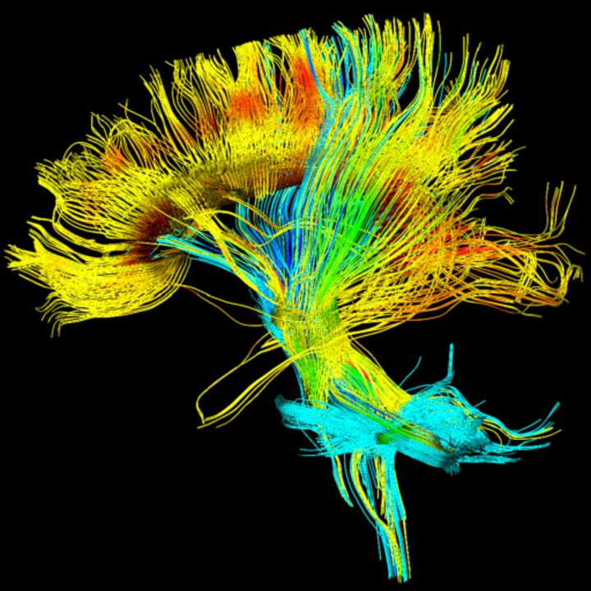
3D rendering
Notes:
Ref: https://www.healthcare.siemens.com/magnetic-resonance-imaging/options-and-upgrades/clinical-applications/syngo-dti-tractography

Slide 45
References
http://atlas.likar.info/Prodolgovatyiy_mozg/
http://dic.academic.ru/dic.nsf/ruwiki/99990
http://meduniver.com/Medical/Anatom/385.html
http://emed.nextday.su/razdel/35/318/19775/
http://www.what-this.ru/people/brain_departments/brain_ordered_structure.php
http://www.medbiol.ru/medbiol/mozg/0004593b.htm
http://www.what-this.ru/people/brain_departments.php
http://www.nervus.ru/golovnoy-mozg.html
http://www.claw.ru/a-man/1970.htm
http://coma.su/content/view/65/55/
http://www.diabet-gipertonia.ru/insult/01_anatomia_mozga.html
http://dic.academic.ru/dic.nsf/enc_medicine/19230/
http://dic.academic.ru/dic.nsf/ruwiki/8694
http://www.braintools.ru/parts-of-the-brai

Slide 46
References
Introduction to Diffusion Tensor Imaging, Susumu Mori.
Diffusion tensor imaging and fiber tractography of human brain pathways, Brian Wandell.
http://mriquestions.com
https://www.slideshare.net/madlymissyou/2011-0929-diffusion-weighted-mri

